Slide 1
International Diversity Standards according to ISO 30415 How can they serve and be implemented in Sachsen-Anhalt’s Educational Institutions? Presented By: Razia Gul Mohammad
1

Slide 2
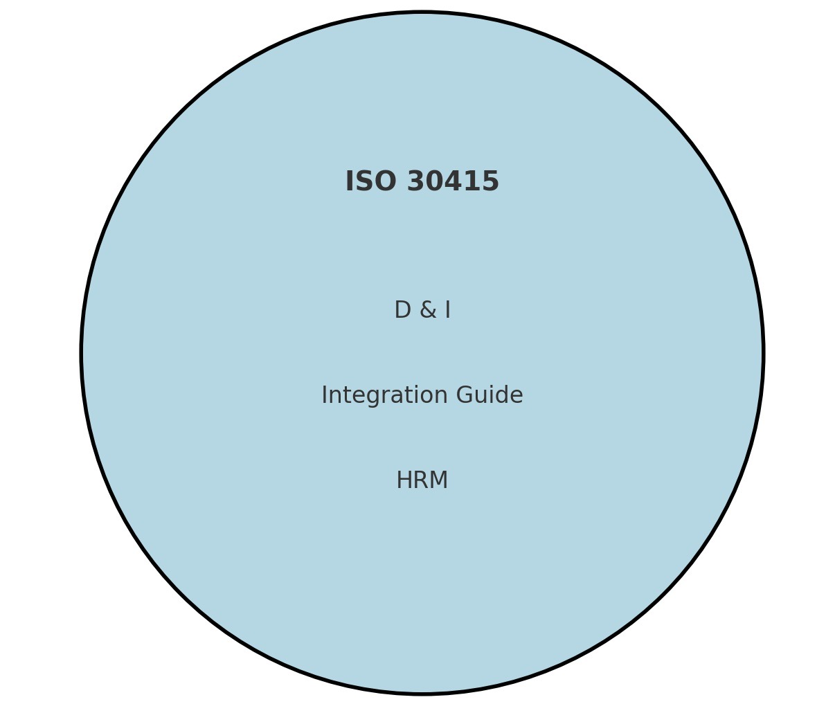
Understanding ISO 30415 Standards
What is it?
Why is it Important?
Why is it Sufficient?
2

Slide 3
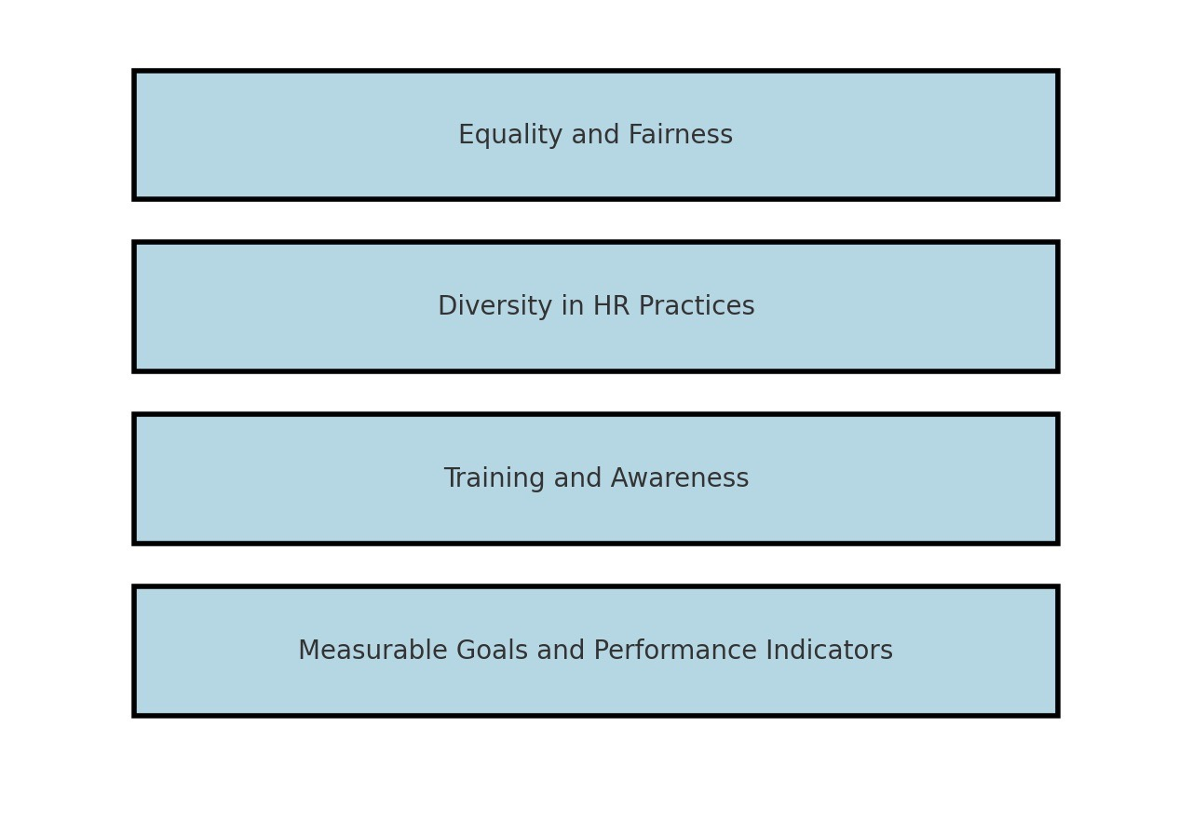
ISO Indicators
3

Slide 4
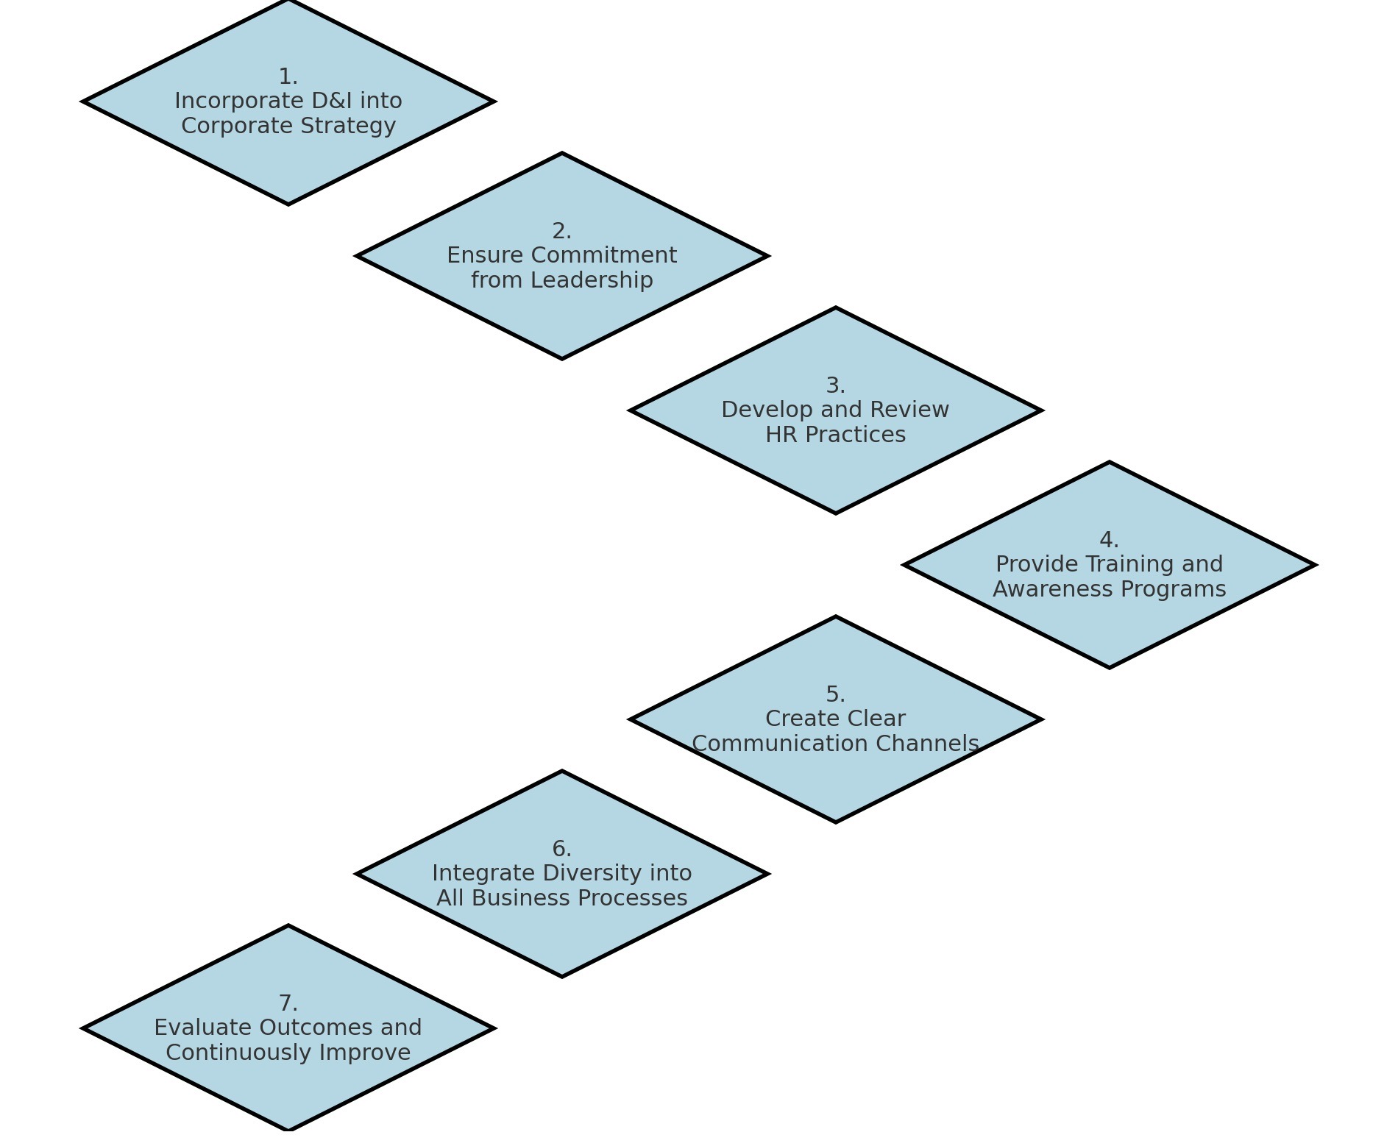
ISO Implementation
Source: (Eurosysteam 2023)
4

Slide 5
Evaluation
Observation of equal treatment in the workplace
Check of HR Processes
Participation and observation in diversity trainings
Assessing the diversity related communications
Observation of diversity in various business functions
Verify if the organization evaluates diversity and inclusion regularly.
5
Source: (Eurosysteam 2023)

Slide 6
Which educational institution or organization uses ISO standards?
6

Slide 7
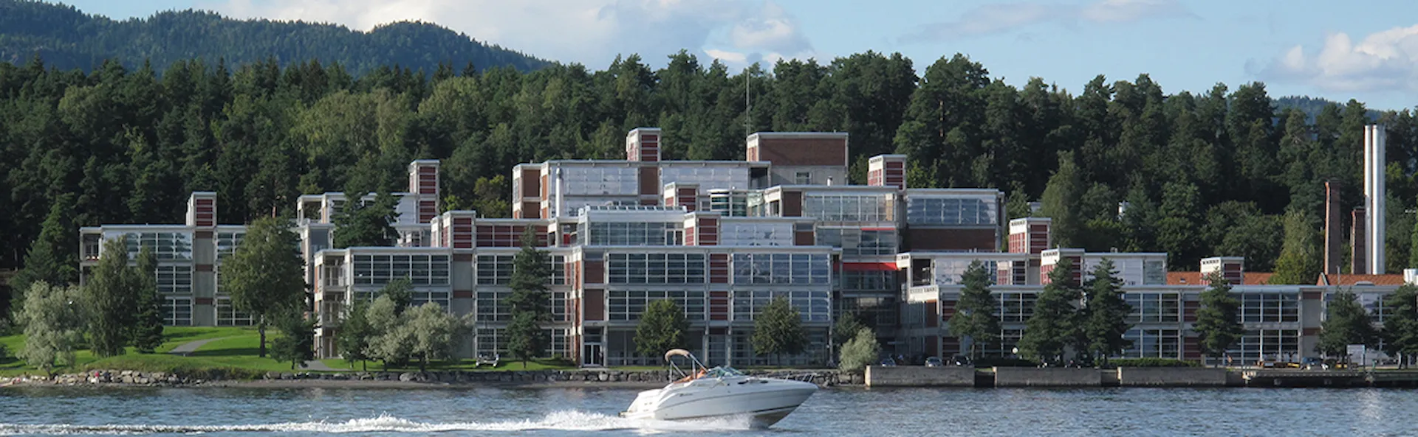
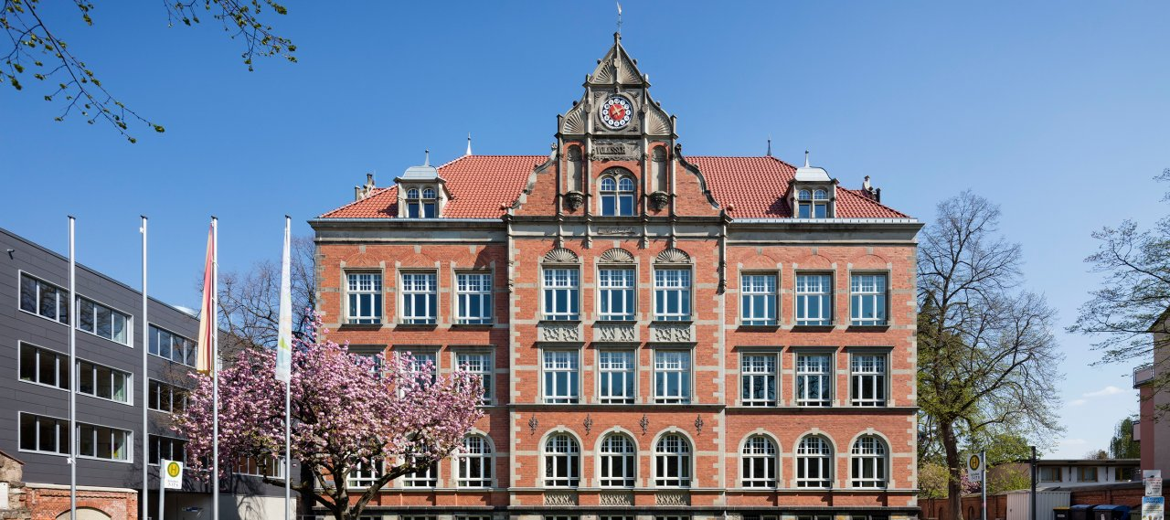
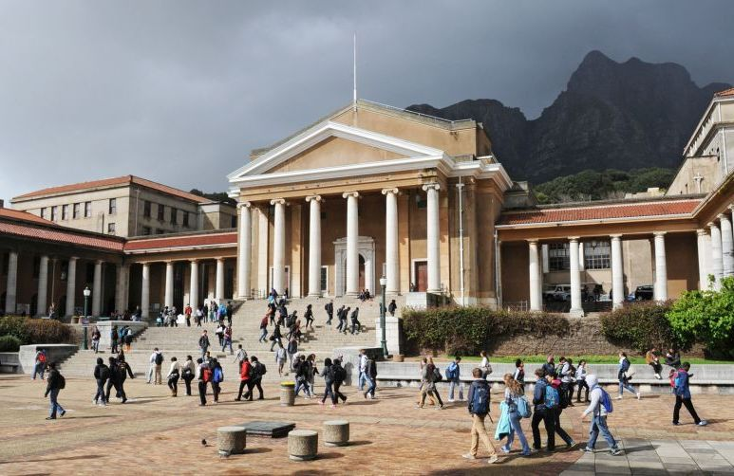
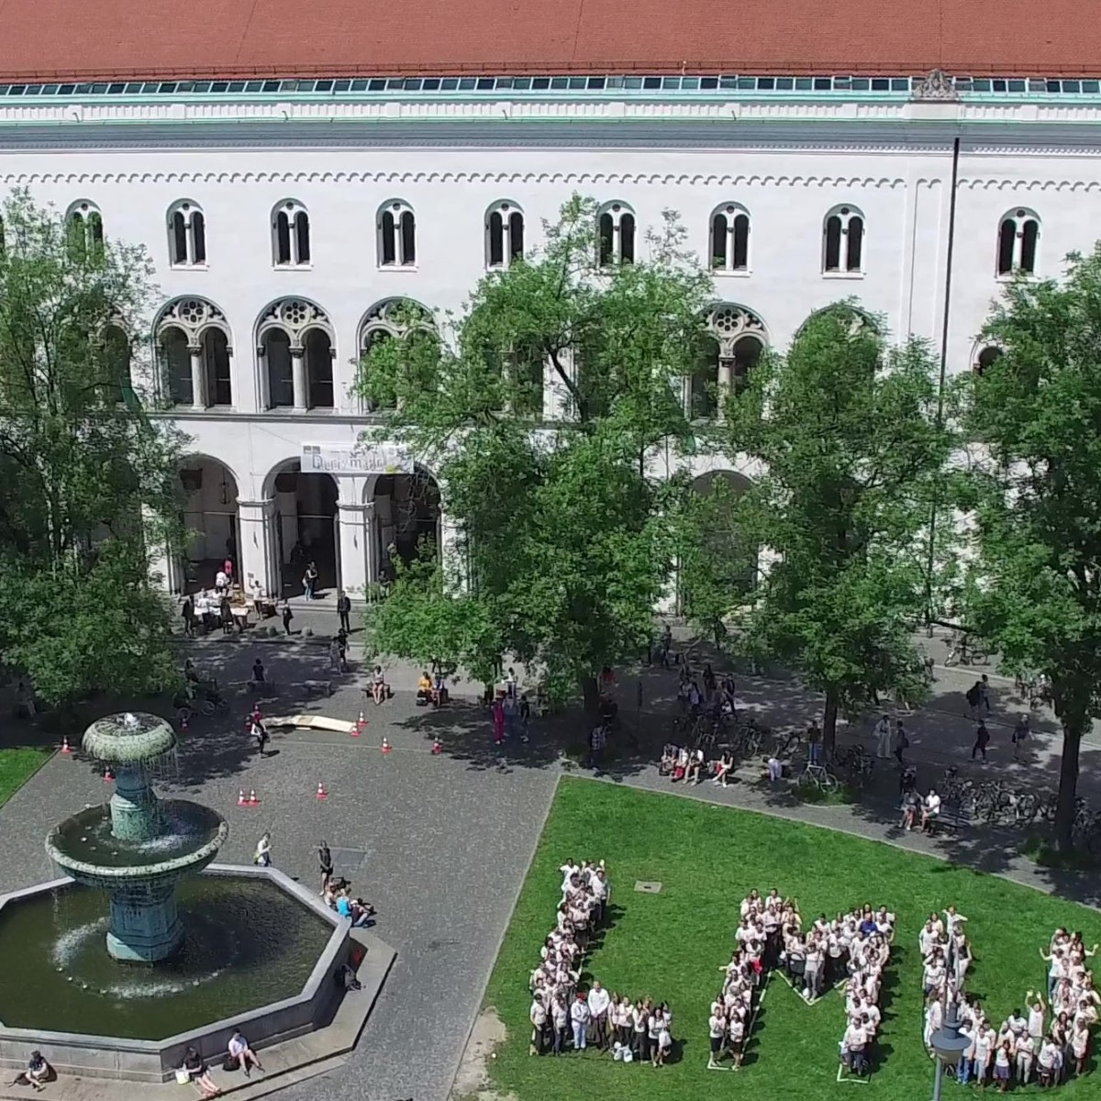
Organization and Educational Institutions
Det Norske Veritas
Marie Kahle Comprehensive School
Source: DNV website
Credit: Jens Kirchner
Det Norske Veritas (DNV): Norway
Marie Kahle Comprehensive School: Bonn
University of Cape Town: South Africa
Ludwig Maximilian University of Munich (LMU)
University of Cape Town
Ludwig Maximilian University of Munich
Source: Global Studies Program
Source: LMU Website
7

Slide 8

Diversity Management Strategies in Sachsen-Anhalt
International Cultural Competence Development
Diversity Management with Service Learning: Vielfalt Nutzen
Gender Equality and LGBTQ+
Queerformat-Education and Diversity Project
Source: PowerPoint Template
8

Slide 9
How ISO Standards Can Serve Sachsen-Anhalt's Educational Institutions?
Enhancing
Enhancing Diversity and Inclusion Efforts
Aligning
Aligning with Existing Strategies
Creating
Creating Equitable Opportunities
Improving
Improving Institutional Reputation
Having
Having Key Benefits
Source: PowerPoint Template
9

Slide 10

Implementing ISO standards in Sachsen-Anhalt’s Educational Institutions
1: Steps for Implementation:
Assessment
Policy Integration
Training Programs
Monitoring and Evaluation
2: Examples of Application:
10
Source: PowerPoint Template

Slide 11
Questions for Discussion
Which organization in Sachsen-Anhalt may implement ISO standards? Will AGSA be the one to implement ISO standards why or why not?
What challenges can be foreseen in implementing ISO standards in Sachsen-Anhalt’s institutions, and how might they be addressed?
11

Slide 12
Thanks for your attention
12

Slide 13
References
https://eurosysteam.com/diversity_iso-30415_gdeib/
https://www.tuvsud.com/en/-/media/global/pdf-files/brochures-and-infosheets/tuv-sud-iso-30415.pdf
https://www.deutschland.de/en/topic/knowledge/improving-access-to-education-initiatives-in-germany
https://www.iso.org/obp/ui/en/#iso:std:iso:30415:ed-1:v1:en
https://www.dnv.com/about/
https://www.welcomecenter-sachsen-anhalt.de/en/information-library-infothek/counselling-and-support/interculturalism-and-dealing-with-diversity/acquiring-intercultural-competence
https://www.bildungsserver.de/innovationsportal/innovationsprojekt.html?innovationsprojekte_id=847
https://queerformat.de
13

Slide 14
Photo Credit
Page 7, top left (Det Norske Veritas): https://www.dnv.de/contact/headquarters/. accessed 11. 02. 2025.
Page 7, top right (Marie Kahle Comprehensive School): https://www.bollinger-grohmann.com/en.projects.comprehensive-school-marie-kahle.html. accessed 07.02.2025
Page 7, bottom left (University of Cape Town): https://www.gsp.uni-freiburg.de/institutions/university-of-cape-town. accessed 11.02. 2025.
Page 7, bottom right (Ludwig Maximilian University of Munich): https://www.lmu.de/en/workspace-for-students/international-student-guide/. accessed 11.02. 2025.
14

